Slide 1
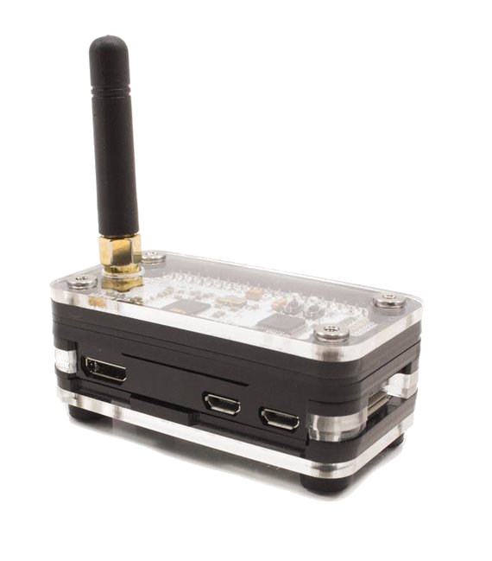
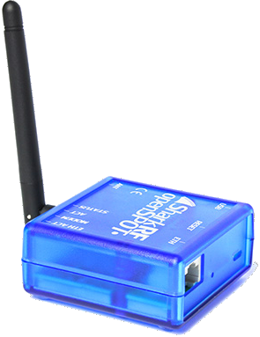
H O T S P O T S
Personal Digital Voice Gateways
W A 9 V F D

Slide 2
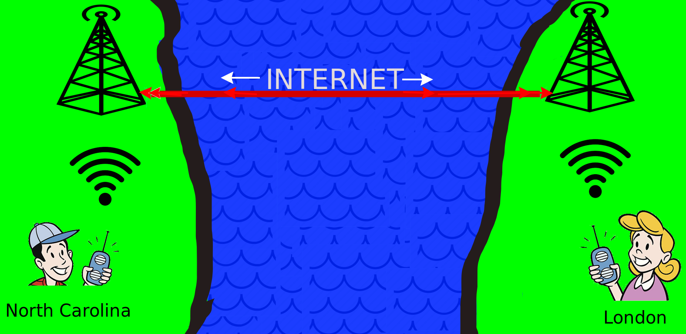
“Digital Voice?”
INTERNET
WA9VFD

Slide 3
“OK, So What?
Internet
openSPOT
Zumspot running
pi-star
Personal HOTSPOT
WA9VFD

Slide 4
“I Still Don’t See The Point”
“I Still Don’t See The Point!”
INTERNET
WA9VFD

Slide 5
WA9VFD

Slide 6
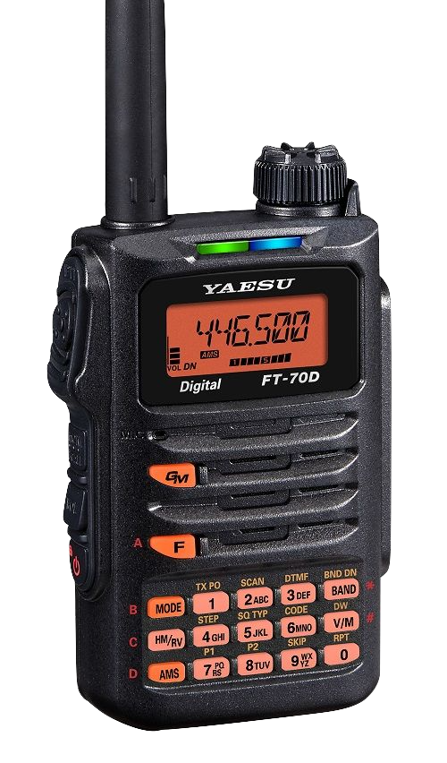
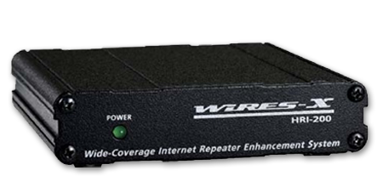
“So...What Gets Me Where?”
YSF Network
FCS Network
Internet
X
X
WA9VFD

Slide 7
vs
C4FM
Internet
Internet
YSF Network
C4FM
Internet
FCS Network
WA9VFD

Slide 8
“So...What Gets Me Where?”
YSF Network
Internet
DMR
FCS Network
Internet
X
X

Slide 9
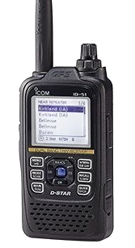
“So...What Gets Me Where?”
D-Star
Internet
X
X
X
WA9VFD

Slide 10
“So...What Gets Me Where?”
X
X
WA9VFD

Slide 11
“Hotspot Repeaters? They can do that?”
INTERNET
WA9VFD

Slide 12
“I Know What I Want This Year”
WA9VFD

Slide 13
H O T S P O T S
Personal Digital Voice Gateways
QUESTIONS?
WA9VFD

